Slide 1

Our Team: BigQuery_Quest
Architecture Lead - Kadiatou Sogodogo
Designed and explained how the system is built and why
Analysis Lead- Karthikeyan Atmakuru
Checked robustness of the DB and compares it against PostgreSQL and Cassandra
TiDB
TechRetail Evaluator – Marta Falceto Font
Assessed how useful and practical TiBD is in a real retail setting
A distributed SQL database
Notes:
BigQuery_Quest - Presenting on TiDB

Slide 2
Today, we’ll cover…
✓ Architecture Overview
✓ CAP Theorem Positioning
Agenda
✓ SQL Compatibility
✓ Scaling Model
✓ Consistency & Transactions
✓ TechRetail Fit
Notes:
How TiDB works, why it’s useful, how it compares to other systems and Whether it is a good fit for TechRetail

Slide 3
SYSTEM OVERVIEW
What is TiDB?
TiDB with "Ti" stands for Titanium, is an advanced open-source SQL database that supports Hybrid Transactional and Analytical Processing (HTAP) workloads (combining OLTP and OLAP).
founded 2015
founded 2015
founded 2015
Created by
Use by
Core Value Proposition
Industries such as:
Finance → secure transactions & data accuracy
E-commerce → high traffic & horizontal scaling
SaaS / Internet Apps → real-time analytics
TiDB powers Bolt, LinkedIn, Pinterest, Square and more
PingCAP, 2015
A company founded by engineers focused on solving database scalability problems at large scale
Real time Hybrid Transactional and Analytical Processing (HTAP)
Easy horizontal scaling
Compatible with the MySQL protocol and MySQL ecosystem
Notes:
TiDB is an advanced open-source SQL database.
What’s unique about it, is that it supports Hybrid Transactional and Analytical Processing workloads (HTAP),
which is a combination of both OLTP day-to-day tasks nserts, updates, and queries and OLAP deep analytical work, within the same system.
"Ti" stands for Titanium. PingCAP chose Titanium as a metaphor for what they wanted TiDB to be:
A strong Highly reliable database,
handle heavy workloads without breaking
You’ll commonly see in industries like finance, where transaction accuracy is critical, in e-commerce where platforms have to handle heavy traffic, and in SaaS or internet applications that rely on real-time analytics.
It’s also used by major companies like Bolt, LinkedIn, Pinterest, and Square, and many more

Slide 4
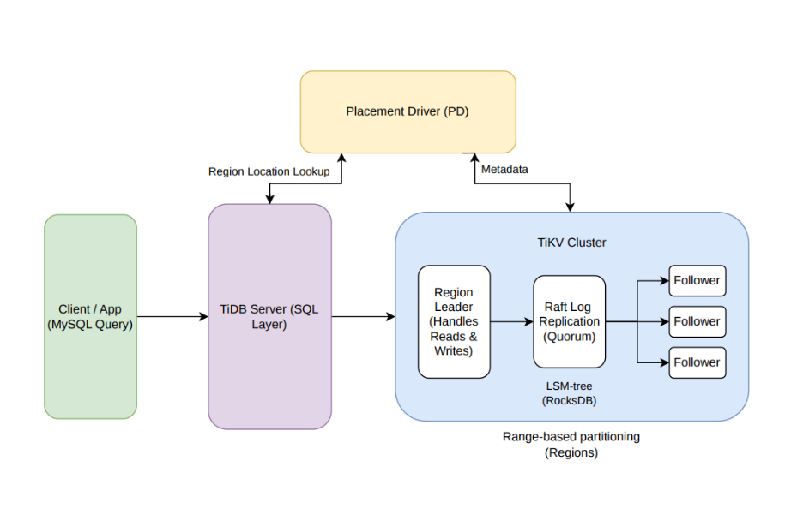
TECHNICAL DEEP DIVE
Architecture Overview
The TiDB architecture design separates computing from storage.
Placement Driver (PD) Server The PD server acts as the “brain” of the system.
Manages metadata, tracks where data is stored
Controls how data is distributed across the cluster
TiDB Server (SQL/ Compute Layer) The TiDB server is the front-facing layer that handles all SQL requests using MySQL protocol. It is stateless
Storage Layer
TiKV TiKV is the main storage engine where data is stored.
It splits data into smaller chunks called Regions, and automatically keeps 3 copies of each Region
It also supports transactions, making it reliable for everyday read and write operations
TiFlash TiFlash is a special column-based storage engine designed for fast analytical queries. It works alongside TiKV to improve performance for reporting and large-scale data analysis.
Notes:
TiDB is made up of THREE components, each with a distinct role.
What’s interesting is thatThe TiDB architecture is designed in a way separates computing from storage,
letting you scale out or scale in the computing or storage capacity as MUCH asneeded.
PD→ manages cluster and data distribution
TiDB → handles queries (compute layer)
TiDB server is stateless, meaning it doesn't remember anything between requests. Each time you send a query, it processes that query from scratch
without relying on any stored information. This makes Storage Layer
TiKV TiKV is the main storage engine where data is stored. It splits data into smaller chunks called Regions, and automatically keeps 3 copies of each Region across the cluster — so if one node goes down, your data is safe and the system keeps running. It also supports transactions, making it reliable for everyday read and write operations
TiFlash TiFlash is a special storage engine built for speed when running reports or analyzing large amounts of data. It works side by side with TiKV —
TiKV handles, while TiFlash steps in when you need fast answers from big data.

Slide 5
TECHNICAL DEEP DIVE
Architecture: How Your Data Flows (TiKV Cluster)
Data Partitioning
Node Roles
Range-based partitioning
Data is split into Regions (key ranges)
Regions are automatically split and rebalanced across nodes
Leader–Follower model within each Region
Leader handles writes, followers replicate data
founded 2015
founded 2015
Storage Engine
Consensus Protocol
Uses Raft (per Region) for distributed consensus
Each write is replicated as a log entry across multiple nodes
A write succeeds only after a majority (quorum) agrees
TiKV uses RocksDB, which is built on an LSM-tree structure
This design is optimized for high write performance by writing data sequentially and merging it in the background
Notes:
Data Partitioning
🗣️Here we have Range-based partitioning
TiDB distributes data by splitting it into Regions based on key ranges. These Regions are automatically split and spread across different servers as the data grows.
Node Roles (Leader–Follower)
🗣️ Each Region is managed using a leader–follower model. The leader node handles all write operations, while follower nodes replicate the data to ensure reliability.
Consensus Protocol
🗣️To keep everything consistent, TiDB uses the Raft protocol. Every Region has its own Raft group, and a write is only successful when a majority of nodes agree
Storage Engine
🗣️Finally, at the storage level, TiDB uses RocksDB with an LSM-tree design, which improves write performance by writing data sequentially and merging it later.

Slide 6
TECHNICAL DEEP DIVE
CAP Theorem
TiDB is CP
TiDB is designed to balance all three as much as possible. It keeps data consistent and handles network issues but might become unavailable during a failure rather than serve outdated data.
Consistency
C
During a network partition
TiDB
The system favors consistency. Writes requiring quorum are blocked until the partition heals. Reads can be served via follower reads to preserve some availability.
Can users configure this trade-off?
A
P
Limited flexibility: replica placement and follower reads (stale reads) improve availability for certain workloads, but the core CP guarantee is fixed by Raft.​
Availability
Partition Tolerance
PostgreSQL = CP
Cassandra = AP
Notes:
TiDB is designed to balance all three as much as possible. It aims to give you strong consistency. It keeps data consistent and handles network issues, but might become unavailable during a failure rather than serve outdated data

Slide 7
TECHNICAL DEEP DIVE
SQL Compatibility
Which SQL standard does TiDB target?
Designed for MySQL compatibility
Supports MySQL protocol, syntax, and ecosystem
Application Migration
Query Performance
Considerations
SQL features missing or limited
No support for stored procedures or triggers
Some limitations in query optimization and execution plans
Slower for queries with heavy cross-node data movement
Large JOINs
Global sorting
COUNT(DISTINCT)
Complex CTEs
PostgreSQL apps → require modifications
MySQL apps → minimal or no code changes
Notes:
1.SQL features missing or limited TiDB doesn't support everything MySQL supports. Specifically:
TiDB doesn't support stored procedures or triggers so any app relying on these would need reworking.
— These are pre-written instructions you save inside a database to run automatically.
Some limitations in query optimization — Sometimes TiDB doesn't find the most efficient way to run a query on its own.
2.Application Migration This is about moving an existing app to TiDB:
Coming from PostgreSQL? You'll need to make code changes because PostgreSQL and MySQL are quite different.
Coming from MySQL? Very little to no changes needed — since TiDB is built to mimic MySQL, your app will mostly just work.
TiDB has to pull data from ALL the nodes, bring it together in one place, do the calculation, then return the result. That "pulling everything together" step is what makes it slow and expensive.

Slide 8
TECHNICAL DEEP DIVE
How TiDB Scales?
Horizontal scaling
Automatic sharding → Data split into Regions (key ranges)
No manual intervention (unlike PostgreSQL sharding)
Dynamic rebalancing via Placement Driver (PD):
Redistributes Regions when nodes change.
Balances load + ensures availability.
Notes:
Horizontal Scaling
When data grows, you add more machines — not upgrade one big server
Each layer scales independently — more TiDB nodes for queries, more TiKV nodes for storage
Automatic Sharding
TechRetail manually splits data into NE and SE databases — adding a new region means rewriting routing logic and migrating data manually
TiDB splits data automatically into chunks called Regions — each Region is ~96MB of consecutive data
When a Region grows too large TiDB splits it — when too small TiDB merges it — no developer involvement
Dynamic Rebalancing via PD
Placement Driver (PD) is the manager — decides which Region lives on which machine
New node added → PD automatically moves Regions to it to balance load equally
Node crashes → PD immediately creates new copies of lost data on healthy machines
All of this happens in background — no downtime, no manual work.

Slide 9
TECHNICAL DEEP DIVE
Consistency & Transactions
founded 2015
Isolation Levels
Default: Repeatable Read (Snapshot Isolation)
Also supports: Read Committed
Ensures consistent reads within a transaction
Prevents dirty reads and inconsistencies
Distributed Transactions
Trade-offs
Uses Two-Phase Commit (2PC)
Coordinates transactions across multiple nodes
Works with Raft for replication
Guarantees atomicity and consistency
Strong consistency increases latency
Reduces throughput vs AP systems
More coordination between nodes required
Trade-off: Consistency vs Performance
Notes:
Default is Repeatable Read (Snapshot Isolation) — when your transaction starts, TiDB gives you a private snapshot of the data. Your view stays clean and consistent throughout
Also supports Read Committed — each read sees the latest committed data. Slightly less strict but faster in some cases
Both prevent dirty reads — you never see inventory that is mid-update by someone else's transaction. Distributed Transactions
When you hit buy — that 1 to 2 minute wait is Two-Phase Commit (2PC) running
Phase 1 — TiDB locks all data it needs across machines. Checks inventory, verifies payment, confirms queue position — all simultaneously
Phase 2 — if all checks pass, applies all changes together and releases locks. Order created, inventory reduced, payment confirmed — all atomic
If anything fails in Phase 1 — everything cancels. No charge, no order, no inventory change. Clean rollback. Trade-offs
That 1 to 2 minute wait is the trade-off — Raft quorum and 2PC add latency
Cassandra confirms in milliseconds but risks overselling — sells the same shoe to multiple people
TiDB takes longer but when it says confirmed — it is genuinely confirmed. Consistency vs Performance
For a limited edition sale where overselling is a disaster — TiDB's approach is the right one

Slide 10
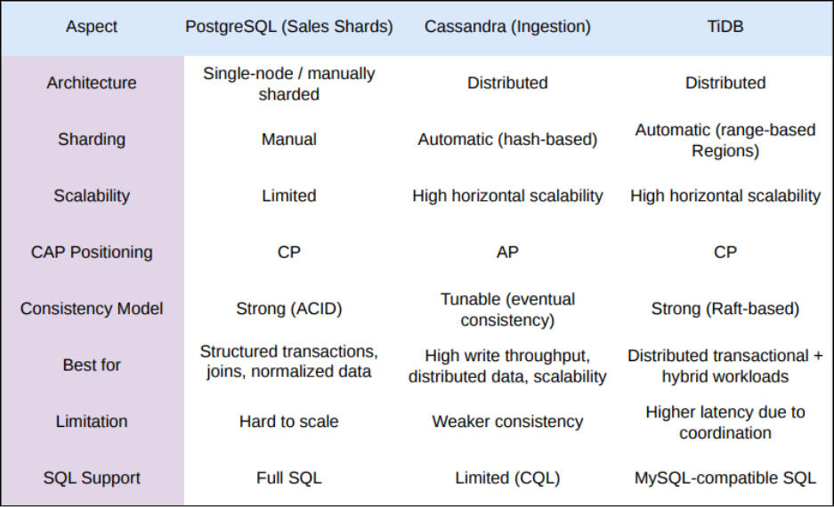
TECHNICAL DEEP DIVE
Comparison Table: TiDB vs PostgreSQL and Cassandra
Notes:
Best for
PostgreSQL — best for structured transactions, complex JOINs, and normalized relational data. Ideal when data has relationships between tables and accuracy is critical
Cassandra — best for high write throughput, distributed data at massive scale. Ideal when you just need to store enormous amounts of data very fast without complex querying
TiDB — best for distributed transactional AND analytical workloads together. Ideal when you need PostgreSQL's correctness at Cassandra's scale — which is exactly TechRetail's situation
Limitation
PostgreSQL — hard to scale. Once you hit the ceiling of one machine you have to manually shard like TechRetail did — splitting into NE and SE databases
Cassandra — weaker consistency. It can give you incorrect or stale data because it skips the checking process for speed. As we discussed — it prints the receipt without checking stock
TiDB — higher latency due to coordination between machines. Every write waits for Raft quorum agreement across multiple machines — adding a few milliseconds compared to Cassandra
SQL Support
PostgreSQL — full SQL. Every SQL feature, JOINs, complex queries, window functions — all supported
Cassandra — has its own limited query language called CQL — Cassandra Query Language. It looks like SQL but cannot do JOINs, complex filters, or aggregations. You can only query data the exact way you designed the table for
TiDB — MySQL compatible SQL. Developers use the same SQL they already know. The only adjustment needed is minor syntax differences when migrating from PostgreSQL
"Each system is best at one thing, limited by one thing, and speaks its own version of SQL — PostgreSQL is powerful but cannot scale, Cassandra scales but cannot stay correct, and TiDB sits in the middle — scalable, correct, and speaking a SQL language developers already know."

Slide 11
TECHNICAL DEEP DIVE
TechRetail Fit
Can replace:
PostgreSQL shards (sales layer)
Potentially reduce need for warehouse
Provides:
Single unified database instead of multiple shards
Simplifies:
Query routing
Application logic
Supports:
Hybrid workload (OLTP + OLAP)
Notes:
Can Replace
Replaces both PostgreSQL sales shards — NE and SE become one unified database. No manual routing logic needed
Cross region query like total sales across all regions becomes simple SQL — TiDB handles it internally
Potentially replaces the data warehouse — TiFlash provides live columnar analytics on data seconds old. No nightly ETL batch needed
Simplifies
No more routing logic — application does not decide which shard to query. Just talks to one database
Application logic becomes significantly simpler overall
Supports Hybrid Workload — OLTP + OLAP
OLTP — fast transactional operations like placing an order — handled by TiKV
OLAP — heavy analytical operations like monthly revenue reports — handled by TiFlash
Normally these two conflict and need separate systems. TiDB handles both simultaneously
TechRetail built 4 separate systems to solve 4 separate problems. TiDB solves all 4 in one.

Slide 12
TECHNICAL DEEP DIVE
Should TechRetail Use TiDB?
founded 2015
founded 2015
Where It Fits ?
Benefits
Automatic sharding & rebalancing
No manual data routing
Simplified ETL pipeline
Supports OLTP + OLAP workloads
Replace PostgreSQL sales shards
Reduce dependency on separate warehouse
Single unified distributed database
Simplifies application architecture
Challenges
Final Verdict
Distributed system complexity (Raft, coordination)
Higher latency vs Cassandra
Requires cluster management
May not match warehouse for heavy analytics
Best for scalable, unified systems
Not ideal for ultra-high-speed or heavy analytics workloads
Recommended for TechRetail sales layer modernization
Notes:
Slide 5 — Should TechRetail Use TiDB?
Where it fits
It Replaces PostgreSQL sales shards — single unified distributed database
It Reduces dependency on separate warehouse
It Simplifies entire application architecture
Benefits
Automatic sharding — no manual routing ever again
No ETL pipeline — TiKV and TiFlash sync automatically inside TiDB
Supports OLTP and OLAP together in one system
Challenges
Distributed system complexity — managing Raft, PD, TiKV, TiFlash all together
Higher write latency than Cassandra due to quorum agreement
May not match a dedicated data warehouse for extremely heavy analytics — TiFlash shares resources with live transactions. A dedicated warehouse has no competition for resources
Final Verdict
Best for scalable unified systems needing both transactions and analytics
Not ideal if you need Cassandra level raw write speed or extremely complex historical analytics
Recommended for TechRetail sales layer modernisation — right direction, right time when they expand beyond 2 shards
Closing line: TechRetail does not need four systems talking through an ETL pipeline. With TiDB — they need one.

Slide 13
TiDB
References
PingCAP. TiDB Storage Documentation. https://docs.pingcap.com/tidb/stable/tidb-storage/
PingCAP. Transaction Isolation Levels. https://docs.pingcap.com/tidb/stable/transaction-isolation-levels/
DBDB.io. TiDB Overview. https://dbdb.io/db/tidb
Git Repository: https://github.com/KarthikeyanAtmakuru/ism6562-Midterm_project_BigQuest_Query.git

Slide 14
Thank you
Q&A

